Slide 1
Psychology of Affect and Relationships
The Biology of Emotions: What drives motivation?
Why it is important for us to care and how our professional relationships can make a difference
Scott I-Patrick
Educational Psychologist

Slide 2
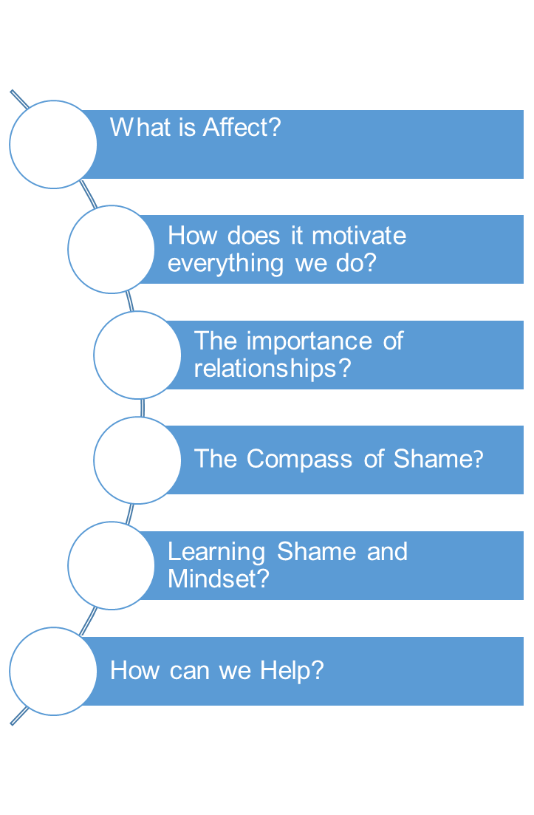
Outline

Slide 3
What is Affect?
A biological programme hard wired into our central nervous system from birth. It is a brief biological response to stimulus conditions - with an evolved function of directing our attention to what is important for us to care about/focus our attention on.

Slide 4
The Affect System in the Brain Consists of Nine Affects (Tomkins (1962)
Positive Affects
Interests - Excitement
Enjoyment-Joy
Neutral Affects
Surprise - Startle
Negative Affects
Distress - Anguish
Fear – Terror
Anger – Rage
Shame – Humiliation
Disgust
Dismell
Notes:
Each of the 9 affect is triggered when our sensory system perceives a certain signal in the environment around us
Each affect is triggered by very specific set of stimulus conditions. For example:
Fear – terror – is response to our senses picking something too big, too loud or too fast.
When our senses encounter a novel stimulus that is just right - interest- excitement is triggered.
Distress –anguish - is the response triggered when too much has been happening for too long.
Enjoyment-joy - is the affect triggered when that too much finally stops happening.

Slide 5
Motivation and the Cognitive System
Affect motivates everything we think or do. We are all wired from birth to experience positive and negative affect based on stimulus conditions around us. We care - are motivated to automatically seek more positive feelings and to stop negative feelings.
The affect system works in conjunction with many other brain systems - Cognitive systems)
Memory - ability to analyse and compare experiences
Scene – Stimulus – Affect - Response
Scripts
Feelings
Emotions
Notes:
Feelings – describes the situation when we become consciously aware that an affect has been triggered.
Emotions – scripted responses arising from our complex interaction between us and our social relationships and our brains motivational and cognitive systems effects on those interactions.
EXAMPLE OF SCRIPT FORMATION
Hungry baby cries (Stimulus = hunger; Affect = distress; Response = crying)
Caregiver picks baby up, feeds her and she experiences relief of hunger (Stimulus = relief of hunger and distress; Affect = enjoyment-joy/contentment; Response = smile/body relaxes).
Each time this happens, cognitive system collects the scenes that are similar and organise them into groups and remembers them. As time passes, baby learns that every time she experiences distress a person appears to help reduce the negative affect of distress – whether created by hunger or something else.
Baby begins to have a great deal of interest in the appearance of that person and associate the person the general group known as people and the very specific person who attends always.
The affects of distress, enjoyment and interests are the powerful motivators behind this learning
Basic message of the script is that people help relieve my distress, give me enjoyment and are interested in me, and therefore I am interested in them.

Slide 6
The Central Blueprint
Maximise positive affect
Minimise negative affect
Minimise the inhibition of affect
Maximise the power to maximise positive affect , minimise negative affect, and minimise the inhibition of affect.
Notes:
The how and why of caring and the primary motivation of all human behaviour is directed by the four rules of the blue print.
Well-being results from a life lived with 1-3 as much as circumstances permit. When this is the case no 4 progressively generates more and more advanced skills to carry out 1-3.
So our personality, the type of people that we are is determined by our scripted responses from past experiences – our theory of life. – In Attachment theory it is referred to as the internal working model.

Slide 7
The Importance of Relationships
What is the evolved function of affects?
Focus on the ‘Affect’ – ‘Shame’
Notes:
So, Affect’s evolved function is to focus our attention on any impediment to our happiness/well-being
I want to look at shame affect more closely – what triggers it? Let’s agree that its evolved function like the others is to focus our attention on anything that impedes our good feeling of joy-excitement.
It turns out empirically that most of the experiences of interest and joy that get impeded have to do with social joining. So we think of shame as an interpersonal/interactional affect.
Once positive affect is impeded, affect shame focuses attention on the impediment.
Now, the thing is what we see in the moment of shame is something in us that isn’t perfect – scripted emotions.
Now maybe I am the only one in the room that has aspects of myself that isn’t perfect, but those of us who are perfect can understand the problems of the rest of us - that there are many areas that we feel insecure about.
Our innate reaction is to fulfil the requirement of the central blueprint which is to resolve the impediment to or feeling of joy-excitement and minimise shame.
We go through a brief moment where we feel awful, and then we decide – right are we going to pay attention to what shame has revealed?

Slide 8
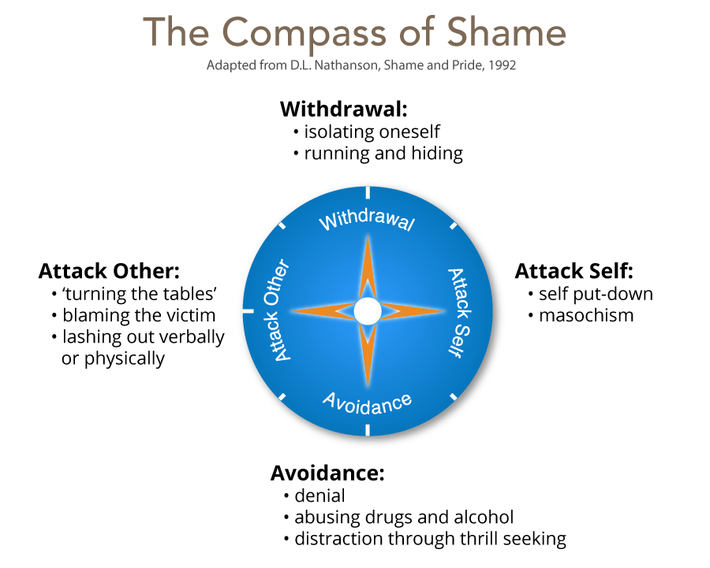
How Do We Resolve Uncomfortable Feelings
Notes:
When we don’t know how to resolve the impediment that shame has brought to our attention, there are 4 universal systems of defence against the information shame wants us to consider. We shift to what we call the compass of shame. (William Nathanson)
The 4 poles of this compass are: see slide
At each pole is a library of responses or scripts for things to say and do when shame strikes and we don’t know how to deal with it honestly.
Withdrawal
Different ways we try to conceal ourselves to prevent others from having what we feel is another reason to hold us in contempt - because some sort of weakness or defect has been exposed.
Attack self
This contains scripts that we can follow to show us how to accept the idea that only through a reduced status in life can we have any relationships at all.
Withdrawal and attack self poles produce peculiar and highly specific ways of living small – living a diminished life.
At the 2 remaining poles, we find contrasting sets of ways of handling shame.
Avoidance
Those that know that shame feels awful - but rather than look at where the spotlight of shame directs their attention they decide to evade the feeling to make it go away so they don’t have to pay attention – self-harm, sexualised behaviour, drugs, alcohol
Attack others
Those that get into the situation in which self deprecation or avoidance hasn’t worked and they engage in behaviours aimed at reducing the self-esteem of someone else to turn the tables to make the other person feel awful.

Slide 9
What Does it All Mean?
Affects trigger themselves, so that what is triggered in me triggers the same in someone that I am dealing with – which is why emotion is contagious.
Knowing this and thinking of children who we work with who we feel have impediment to their excitement and joy
How can we help them maximise positive affect and minimise negative affects through our relationship with them directly and/or with their wider social systems?

Slide 10
Learning Shame
Withdraw - Switch off from learning and not attend lessons.
Attack self - Put themselves down, assume they are dumb.
Avoid - Be the class clown, focus on other aspect of their lives, take risks, use drugs etc.
Attack other - Put others down, belittle value of work, diminish someone, bully others.

Slide 11
Cognitions, Affects, & Behaviours Associated with Mindset
Pupils have certain self-theories about their ability and have a set of scripts around learning.
Mindset – Shame Affect is central to complex learning.

Slide 12
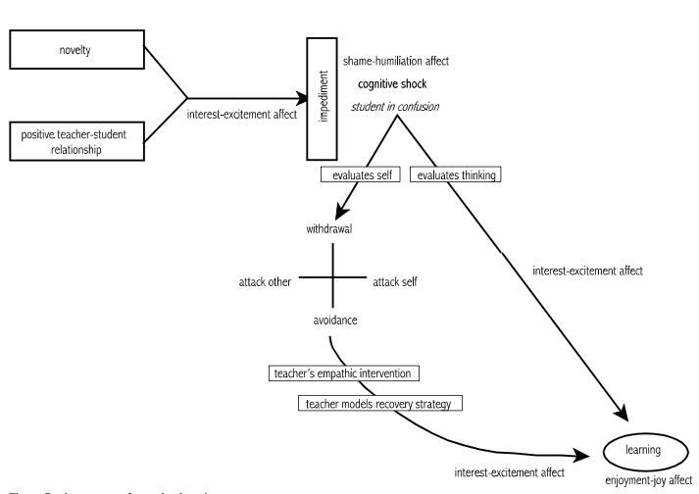
The process of complex learning (George, 2014, p.224)

Slide 13
Fixed Mindset
Pupils believe that their capabilities are fixed since they are part of the self and the self is fixed and constant.
Stimulus = Challenge = self-doubt, helplessness
Affect = distress, fear, anger, shame
Behaviour = risk avoidance, defensiveness, competitiveness, withdrawal hostility, lying.
Notes:
They attributes success to innate qualities of the self and sees failure as evidence that the Self is faulty (shame prone).
THE WORLD IS ABOUT MEASURING YOUR ABILITY. IT IS A WORLD OF THREAT AND DEFENCES.

Slide 14
Growth Mindset
Pupils believe that capabilities can be developed through effort, i.e., through behaviour.
Stimulus = Challenge = self-confidence, aspiration
Affect = interest-excitement, enjoyment joy
Behaviour = high effort, challenge-seeking, cooperativeness, persistence
Notes:
Attributes success to effort and behaviour and sees failure as a need to work and study harder (guilt prone).
THE WORLD IS ABOUT LEARNING AND GROWTH. IT IS A WORLD OF OPPORTUNITIES TO IMPROVE.

Slide 15
Questions to consider about the Mindset of the pupils you support?
What is their desire/ motivation for learning?
How do they evaluate situations?
How do they deal with setbacks?
How do they deal with setbacks?
How do they perceive danger?
How do they perceive effort?
How do they respond to criticism?
How do they perceive others success?
Notes:
These determine outcome: achieve less than full potential or reach ever higher levels of achievement.
Desire/motivation for learning:
is learning about looking smart in every situation, proving themselves and never failing, or
is it about taking risk, learning, and thriving on challenges?
How do they evaluate situations?
Do they think of challenges in terms of success or failure, looking smart or dumb, or
Do they see tasks as opportunity to grow and/or them do better in future.
How do they deal with setbacks?
Do they attribute setbacks as them being a failure (self-identity) – shame-like, I can’t do this (attack self), or
to their behaviour - I failed (behaviour – guilt-like), I need to try harder, do things differently.
How do they perceive change?
avoids challenges, get defensive, or give up easily (compass of shame), or
embrace challenges, persist in the face of setbacks (employs interest)
How do they perceive effort?
thinks effort indicates low intelligence, or
that growth and learning require effort?
How do they take criticism?
ignore constructive criticism, it can’t help, or,
learn from it, how can I improve?
How do they perceive success of others?
feels threatened by others success (shame affect), or
finds lessons and inspiration in others success.

Slide 16
How Can We Help?
Empathic intervention – cant happen without trust and mutual respect (unconditional positive regard)
Promote a growth mindset
Establish high expectations (not just high standards).
Create a risk-tolerant learning zone
Give feedback that focuses on process – things that he can control
Focus on how tasks/activities are framed and how feedback is provided

Slide 17
Framing tasks
Example of communicating learning goals: we are in the learning zone today; mistakes are our friends!
Communicating high expectations
Example of communicating high expectations: As you learn this, mistakes are expected. Your mistakes help me to support you. Let’s make mistakes together!
Giving feedback:
example of when he struggles despite strong effort: I admire your persistence and I appreciate your hard work. It will pay off!
Example of when he struggles and needs help with strategies: Let’s do one together…
Example of when he is making progress: I see you using your strategies/tools/notes etc. keep it up!
Example of when he succeeds with strong effort: I am very proud of you for not giving up and look what you have to show for it!

Slide 18
It is all about relationship quality and our willingness to engage.
Thank You
Please do not use or copy any slides without prior permission from Buckinghamshire EPS

Slide 19
References
George, G. (2014). Affect and Emotion in a Restorative School. In V. Kelly & M. Thorsborne (Eds.), The Psychology of Emotions in Restorative Practice (First, pp. 200–231). Jessica Kingsley.
Dweck, CS, 2012, Mindset, Constable & Robinson, London, 2012
Kelly, V. C. (2014). Caring, Restorative Practice and the Biology of Emotion. In V. Kelly & M. Thorsborne (Eds.), The Psychology of Emotions in Restorative Practice (First, pp. 200–231). Jessica Kingsley.
Nathanson, D.l. (1992) Shame and Pide: Affect, Sex, and the Birth of the self. New York, NY: W.W. Norton.
Tomkins. S. (2008) Affect Imagery Consciousness: the Complete Edition. New york, NY : Springer.

